Slide 1
6G4Z0024 Web Development Lecture 6: Event listener and handler
Yanlong Zhang
Y.Zhang@mmu.ac.uk

Slide 2
Learning Objectives
Comments
Event listener
Event handler

Slide 3
Last week recap
DOM
DOM selectors
DOM property/method

Slide 4
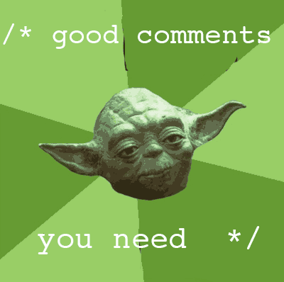
Assessment Criteria
Readability of code
camelCase
Meaningful identifers
Clear indentation
Comments show understanding

Slide 5

COMMENTS in JavaScript

Slide 6
You must use comments to explain what your code does & how
They help you and others understand it
“it works” explains nothing!
vital in industry

Slide 7
MULTI-LINE COMMENTS

Slide 8
/* Anything between these characters is a comment and will not be processed. */

Slide 9
SINGLE-LINE COMMENTS

Slide 10
// use comments to explain // don’t just repeat the code // write for other people

Slide 11
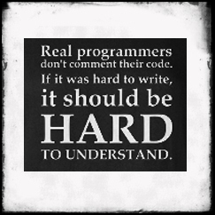
Private coders are NOT popular in their teams!

Slide 12
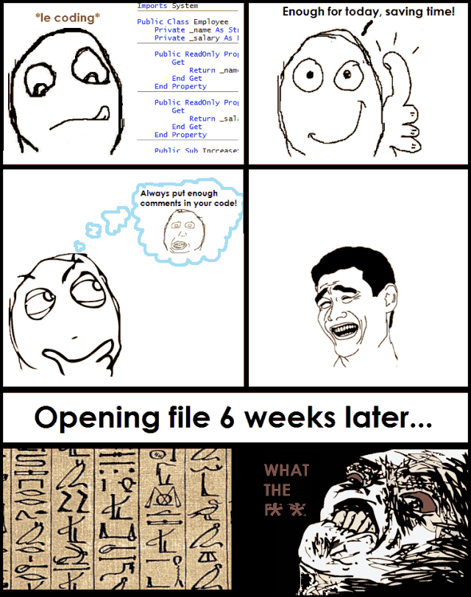
https://medium.com/@biratkirat/step-17-comment-only-what-the-code-cannot-say-kevin-henney-8d06337f168a

Slide 13
// lecture // Lab notes // reference sources express your own understanding
Sources for comments

Slide 14
Also use comments to summarise authorship and sections

Slide 15
Where we’re up to with DOM scripting:
Properties and Methods:
object.property;
object.method();

Slide 16
Things happen in response to events

Slide 17
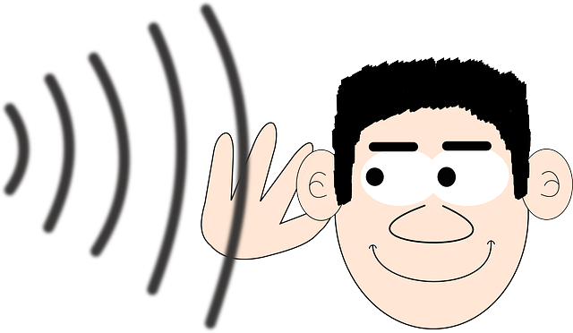
Handling Events with DOM Level 2 Event Listeners
Event-driven scripting

Slide 18
By running code when an event fires, your website responds to the user’s actions. It becomes interactive.

Slide 19
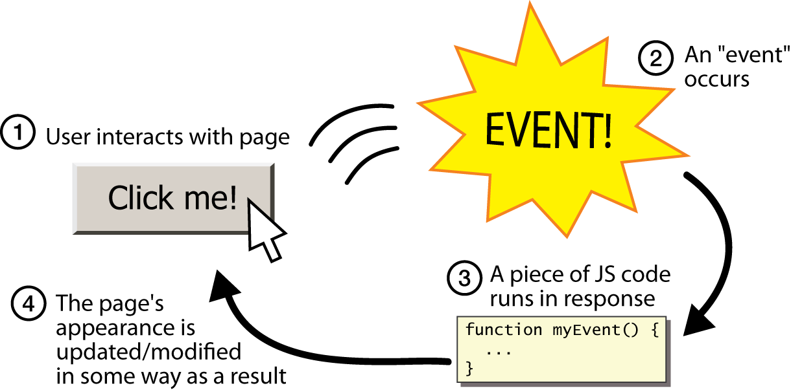
Then we detect event when it happens to that element

Slide 20
DIFFERENT EVENT TYPES

Slide 21
click dblclick mousedown mouseup mouseover mouseout
MOUSE EVENTS

Slide 22
keydown keyup keypress
KEYBOARD EVENTS

Slide 23
load DOMContentLoaded unload error resize scroll
DOM EVENTS

Slide 24
input change submit reset cut copy paste select
FORM EVENTS

Slide 25
HOW EVENTS TRIGGER JAVASCRIPT CODE

Slide 26
1
Select the element node(s) the script should respond to
Using getElementById(), querySelector() etc

Slide 27
2
1
Select the element node(s) the script should respond to
Connect the event that will trigger a response,
to this element

Slide 28
1
2
3
Select the element node(s) the script should respond to
Indicate the event on the selected node(s) that will trigger a response
State the code you want to run when the event occurs

Slide 29
BINDING AN EVENT TO AN ELEMENT

Slide 30
There are three ways to bind an event to an element: 1. HTML event handler attributes 2. Traditional DOM event handlers 3. DOM Level 2 event listeners

Slide 31
The following examples show a click event on an element stored in a variable called myElement that triggers a function called checkUserName().

Slide 32
1. HTML EVENT HANDLER ATTRIBUTES
<input type=“button” id=“user”
onclick=“checkUserName()”>

Slide 33
2. TRADITIONAL DOM EVENT HANDLERS
<input type=‘button’ value=‘click me’ id=‘user’ />
myElement = document.getElementById(‘user’);
myElement.onclick = checkUsername();

Slide 34
<input type=‘button’ value=‘click me’ id=‘user’ /> myElement = document.getElementById(‘user’); myElement.addEventListener(‘click’, checkUsername);
3. EVENT LISTENERS
(recommend)

Slide 35
BINDING AN EVENT TO A HANDLER

Slide 36
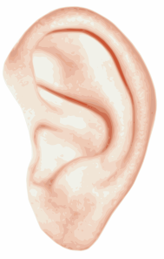


Event Listeners: listening for events
Every DOM element has its own addEventListener method
allows you to listen to any element for an event
clker.com

Slide 37


First we got the HTML element into our own JavaScript variable
const playButton = document.getElementById ( "playPause" ) ;
We want to execute code when the user clicks on this element
How do we find out when the user clicks on it??

Slide 38
..then write code to handle it
playButton.addEventListener ( "click", playPauseVideo );
‘Event handler’
Write a handler function to specify what happens when event happens to that element
Event, target, and handler need to be bound together
Demo

Slide 39
Recommended addEventListener
Can add listener to any element for any DOM event
Can add multiple listeners to same element
Can add listeners for same event to multiple elements

Slide 40
onclick()
const btn = document.getElementById(‘btn’);
btn.onclick = func1();
btn.onclick = func2();
btn.addEventListener(‘click’, func3);
btn.addEventListener(‘click’, func4);

Slide 41
If you put the <script></script>in <head>
Js is executed first
Then content of html is loaded
Issue
Js will use some element which has not been loaded -> error!

Slide 42
All content’s been loaded?
window.addEventListener ( ‘DOMContentLoaded’, runCode) ;
function runCode(){
// all your codes inside this function
}

Slide 43
OR:
window.onload = () =>{
All code in here
}

Slide 44
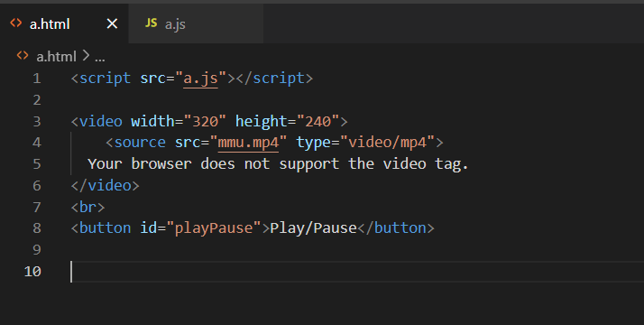
An example

Slide 45
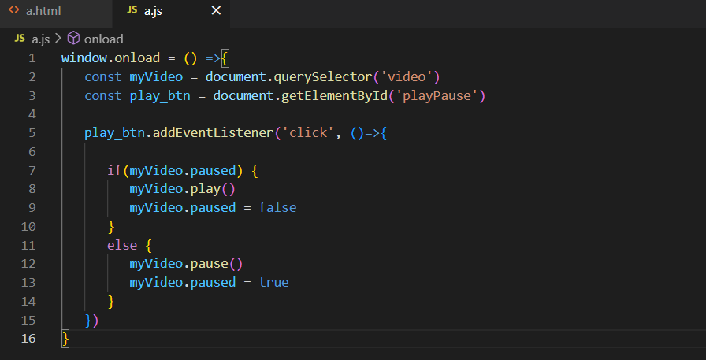
An example

Slide 46
Lab session
Understand DOM scripting
Property
Event
Try more video controls
Mute/unmute
Volume
Full screen toggle
Learn from w3school

